Slide 1
TRICS OVERSEAS
Mike Green
Surrey County Council
Notes:
This is a very short presentation regarding the involvement of TRICS in non-UK areas.

Slide 2
BRIEF HISTORY
2006 - TRICS contacted by New Zealand Organisation “Trip Database Bureau” (TDB)
2007 - TDB Representative presented at the TRICS Conference
2008 – TRICS attended Institute of Professional Engineers New Zealand (IPENZ) conference
2012 - TRICS & TDB Research paper looking into similarities of Trip Rates in UK and New Zealand
Notes:
Back in 2006 TRICS were contacted by a similar organisation in New Zealand. The Trip Database Bureau or TDB had been interested in trip rate production for a number of years and were starting to build a database of trip rates, similar to TRICS. Due to the large number of UK trained Engineers in New Zealand there was an awareness of TRICS in the southern hemisphere.
In 2007 TDB’s Chair, Malcolm Douglass, made the trip to the UK to discuss the possible similarities in travel behaviour across the globe
In 2008 TRICS made a number of presentations at various events, one of which was the IPENZ Conference. It was definitely noted that our experiences in the UK regarding Trip Generation and the assessment of Transport Impact were very similar to those in other parts of the world.
2012 saw the final release of a research paper that had taken a long time to complete. This research looked into the similarities of the data held on the TRICS database with that on TDB’s database. The research is available to TRICS and TDB members and shows that there are some similarities in some land uses.

Slide 3




Notes:
Four cities around the world – Are they actually different? They all have good transport links and millions of people living and working in them. So the big question is, are London, Auckland, Sydney and Tokyo really different in transport terms?

Slide 4

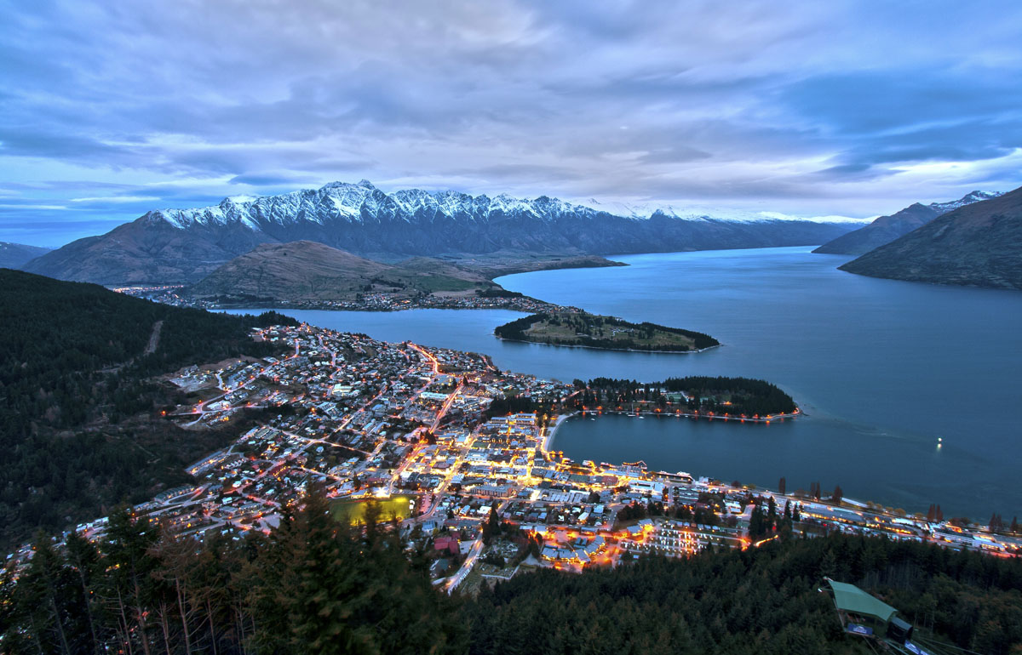
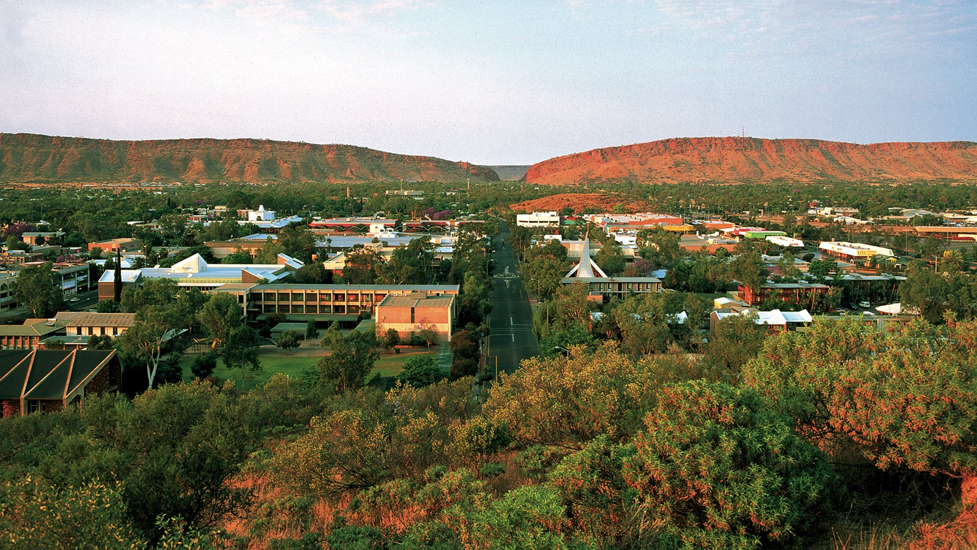

Notes:
Again, are rural towns any different, other than the scenery surrounding them. The residents and workers have very similar problems with the lack of public transport and the reliance upon person travel modes. So, I think that no matter where you are in the developed world, the travel challenges we all face are similar to a degree.

Slide 5
THE GAME CHANGER
Local Government Act restricted the way that TRICS could operate
TRICS Consortium Limited formed in Late 2014
This meant TRICS could actively trade worldwide and in competition with other similar products to the benefit of its core users in the UK
Notes:
Prior to 2014 TRICS was run on behalf of the six Consortium County Councils. The Local Government Act meant that there were restrictions placed upon the way TRICS could be run and the way that the commercial operations could behave.
However, once the Local Authority Trading Company, TRICS Consortium Limited, was created it meant that TRICS could behave like any other product. This opened up the possibility of worldwide membership and expansion of the database.

Slide 6
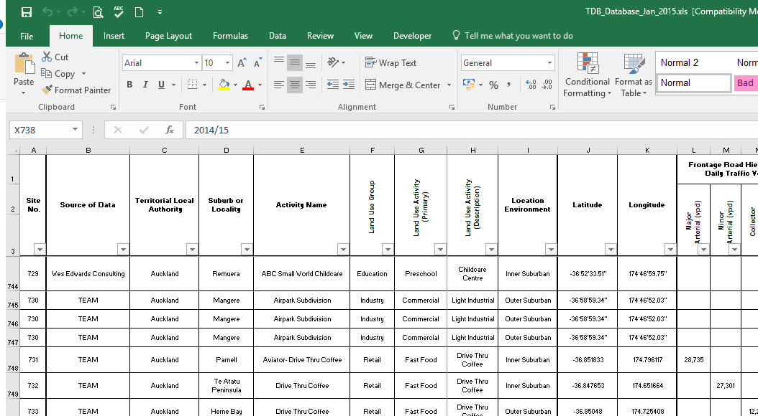
THE OPPERTUNITY
During 2015 TDB investigated various options to update their existing Excel spreadsheet database into a web hosted database
TRICS suggested hosting historic New Zealand and Australian data within the existing database. New Surveys to be undertaken to TRICS methodology.
TDB Board Agreed and work commenced upon a Legal Agreement
Notes:
During the first year of TRICS’ new life as trading company, TDB were starting to investigate a number of options of how they could update their existing Excel based spreadsheet database into a more modern web based system.
For TRICS it made no sense for TDB to develop a new system that would in effect be a version of TRICS. Therefore, a proposal was put to the TDB Board for TRICS to create an area of the database for Australasian data. With new surveys being undertaken to a new TRICS like standard.
This proposal was accepted and a Legal Agreements between TDB and TRICS was signed in April 2017.

Slide 7
BENEFITS FOR ALL
Increase membership of TRICS means a greater spread of the overheads.
TRICS surveys undertaken in another regions gives opportunity to research similarities and differences in travel behaviour.
All users can see how different Transportation policies and developments can influence people, no matter where in the world.
A single database across different regions gives commercial opportunities for users, as retraining is not necessary.
Industry techniques and developments can be easily shared across regions
Notes:
The potential increase in TRICS membership spreads the costs of servers and system developments. Which means more of the membership fees can be spent upon surveys and future research.
Undertaking TRICS surveys in other regions of the world means a standard survey methodology starts to become the norm. This means that it is easier for TRICS members to look at trends and similarities.
We think that the UK is one of the leading lights within the Transportation industry with regard to Transport Assessments and Travel Plan monitoring. However, Australasia is very much looking towards the impacts of driverless cars. Having TRICS covering multiple regions of the world enables the UK to see the influences of new technology before it reaches our shores. Much the same as Australasia benefits from seeing how Travel Plans can influence non-car modes of travel.
The size of the world is shrinking with technology and it is no longer a dis-benefit being a distance away from the project location. A single system covering different regions of the world will give opportunities for TRICS users to work in other locations without the need constantly retrain or learn new systems. On my various visits out to New Zealand and Australia I was amazed at the number of UK Engineers.
There are also benefits in sharing techniques and developments across regions. One of the things that might be introduced to the UK database is the provision on ATC data for the adjacent road network, this is currently undertaken in Australasia, so we will see if this would be applicable and useful within the UK.

Slide 8
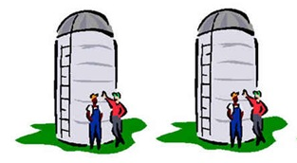
THE multi regional SYSTEM
Each region will have its own separate/segregated area of the database.
UK Region Australasian Region
These silos will ensure database speed is maintained and will enable each database to be region specific.
It is not intended to enable the combination of TRICS data across different regions. However, this would be possible by exporting the data into Excel.

Slide 9
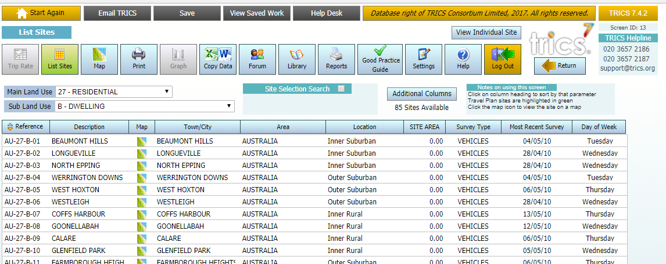
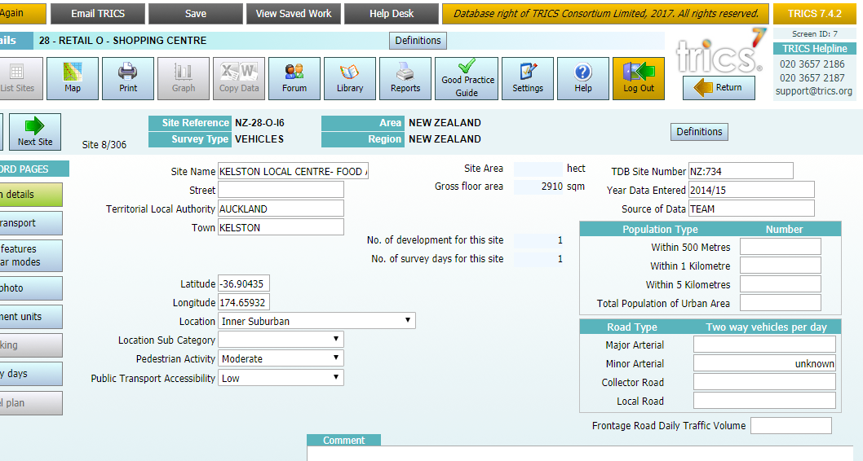
AUSTRALASIAN REGION of the DATABASE
Notes:
As you can see, the system is very much like the UK version. Just with different Land Use categories. We are still working with historic TDB data at the moment, so there are elements of the system that have no information

Slide 10
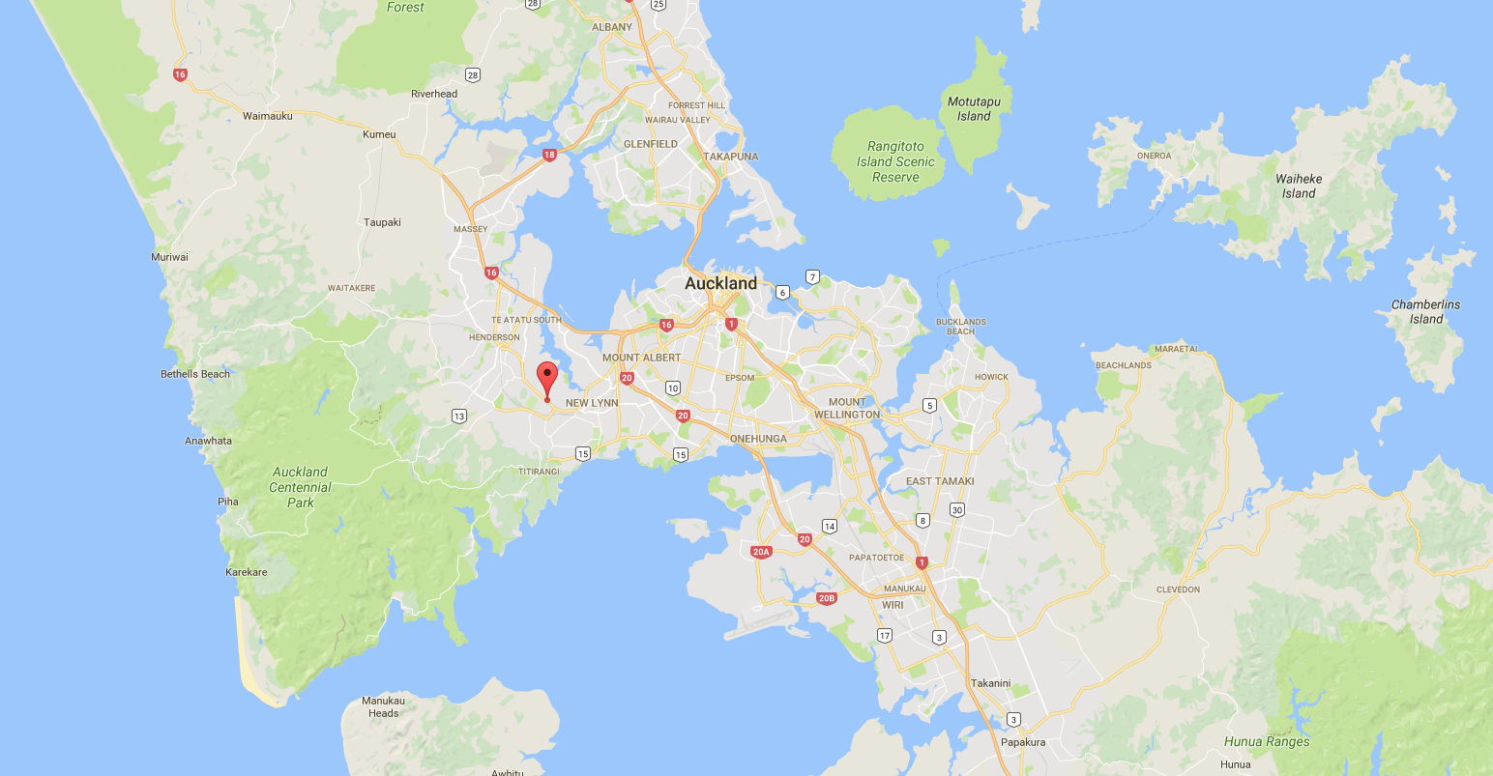
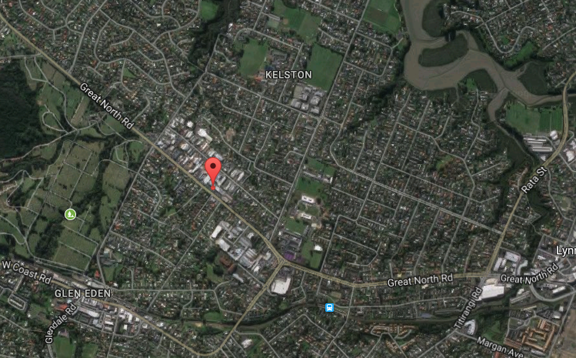
AUSTRALASIAN REGION of the DATABASE
Notes:
The Google Maps feature is very handy, especially when dealing with areas that you do not know well.

Slide 11
TRICS SURVEYS
Surveys in Australasia not currently undertaken to any formal methodology.
Once TRICS System is Operational a Regional TRICS Survey Methodology, based upon UK’s, will be used for all future surveys.
A similar methodology across the regions will allow for research and comparisons to be easily undertaken
Notes:
The data currently held on the TDB Database has different time periods for the surveys and are mostly for only peak hours. Once TRICS creates the Australasian region it will also start to collect data, in conjunction with TDB, to an agreed methodology. This new methodology will be based upon the UK survey methodology and tweaked so that it is southern hemisphere centric and takes account of different land use classifications etc. However, the main point of similarity will be that 12 hour counts will be undertaken and similar information upon non-car modes of transport, such as bus routes and pedestrian facilities will be collected.
This similarity in the methodologies will ensure that data across the regions will be comparable and will enable users to research and compare multi-modal trips.

Slide 12
CURRENT POSITION
Phase One of System Development Complete - creation of the siloed database system so that the data contained is specific to Australasia.
Phase Two of System Development Underway – Individual Site details and surveys created and interact within the Trip Rate Calculation facility
Working towards an early 2018 release date of the system.
TRICS Methodology Surveys included within Australasian database mid to late 2018.

Slide 13
POSSIBLE CHANGES TO TRICS SURVEYS IN UK
TRICS will trial 15 minute surveys in Australasia. If successful we will introduce this to the UK Region.
Australasia record the traffic flow on the adjacent roads. This also might be considered for some surveys in UK Region.
Introduction of new Transport Modes before they hit UK Region.
Notes:
The matter of 15 minute surveys has been discussed for a number of years now. We will trial these surveys in Australasia and see the impacts it has upon database performance and the fact that you increase the data held within the system. If successful we will introduce these in the UK.
TDB also collect the AADT of the development’s adjacent roads. We are going to investigate this and see if it is possible for some levels of TRICS surveys.
Lots of talk about driverless cars within Australasia. It would appear that these may very well be accepted in New Zealand and Australia before anywhere else. This give us the chance to actively work in the region to consider how to survey these new types of transport mode before they come into the UK.

Slide 14
TO CONCLUDE
The world is becoming smaller each year with Technological Developments.
We should learn from other regions experiences.
TRICS and its members have a chance to influence how travel behaviour is surveyed and used outside of the UK.
We all benefit from an increase in knowledge and wider data sources.

