Slide 1

Good Practice: Hints & Tips on Everyday Use of TRICS
Nick Rabbets – Managing Director
TRICS Consortium Limited

Slide 2
Aims of presentation
Give some examples of common problems
Outline good practice recommendations
Give reasons behind recommendations
Helpful things to include within your reports

Slide 3
Most common faux pas in the past
Yes – This still happens!
No outputs
No reasoning behind the figures
No audit trail
These figures could be anything!
Provide the information needed to show ALL readers of your report what you have done and why.
Examination of the TRICS Database shows the development will produce the following additional movements:
Hour | Inbound | Outbound
07:00 – 08:00 | 5 | 32
17:00 – 18:00 | 25 | 10

Slide 4
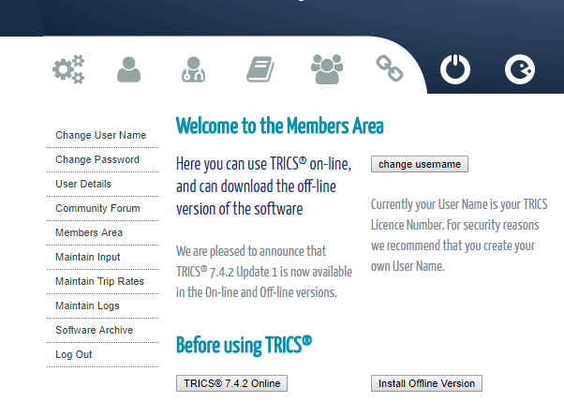
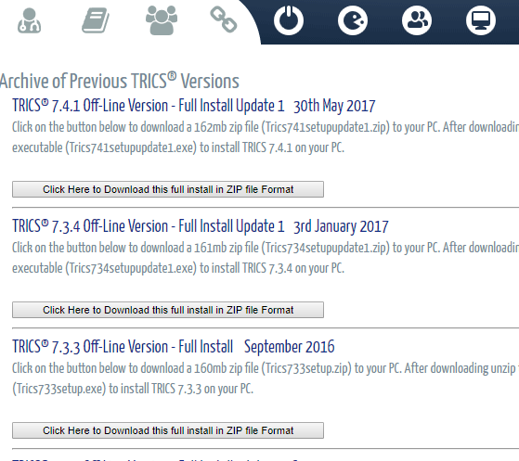
Using old versions of the database
This is not necessarily a complete No No!
Good practice guide says that the latest version of the software should be used where possible.
However, with four releases per year, there will always be data within a report that is not from the current database.
  Have regard to the date of the report, was the then current system used when report was written
  Have there been significant changes since report was written
  Use of older versions of the software should be examined, a 2013 version being used in a 2017 report is questionable

Slide 5

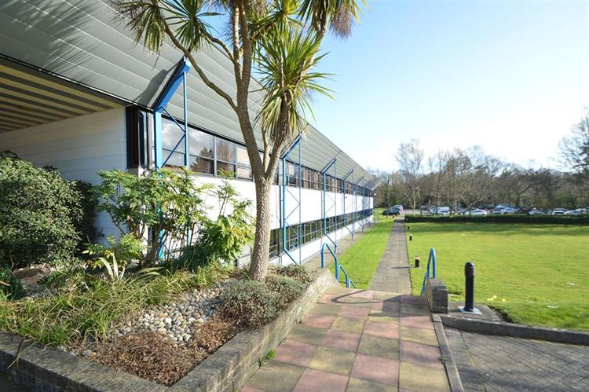
Analysis provenance
Has the TRICS data within the report been produced by those people involved in writing the report for this particular site?
Sometimes it has been know for people to use standard figures, rather than trying to replicate specific development constraints.

Slide 6
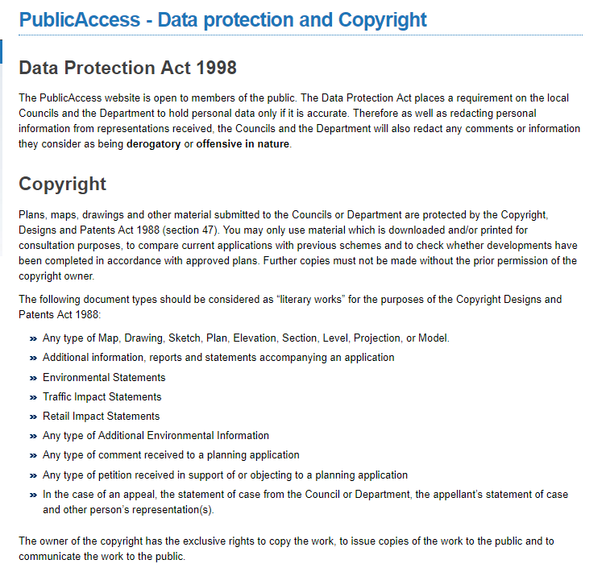
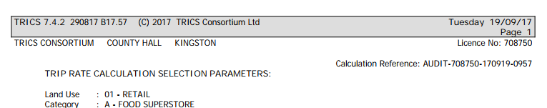
Analysis provenance
In some cases other member organisation extracts have been used without their knowledge.
  Online Planning Portals have copies of all reports associated with a Planning Application, which enables anyone to view its contents.
  The copying of this data is clearly against Copyright Law and is stated in the terms and conditions of use. However, it still does occur and data provided by members is being used without their knowledge.
  Easily policed by Auditors of Reports – Check the name at the top of the outputs and inform the TRICS member that their data has been used by another party.

Slide 7
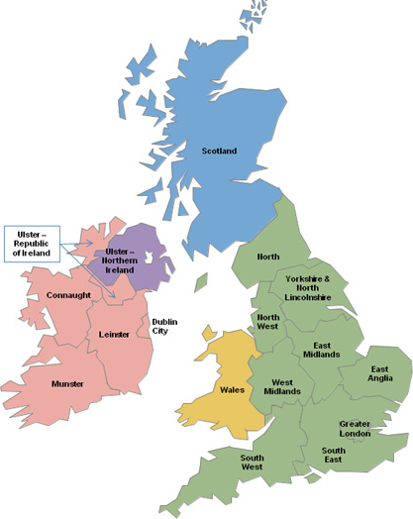
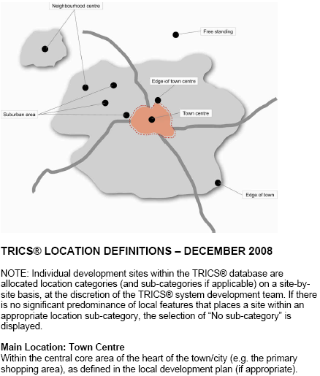
Geographic location
Do not automatically remove a region of the database!
Site location is key.
  Remove individual sites once Primary and Secondary Filtering has been undertaken and you have assessed each individual site.
  State reasons for removal within the provided comment facility.

Slide 8
Don’t get your days muddled
This still happens!
Weekdays and Weekends have different peaks and travel behaviours.
Some uses are even more sensitive.
Food Retail – Saturday and Sundays are different to each other and are completely different to a weekday. However, the Fridays also differ from other weekdays.
Mixing your days can sometimes create a fictional profile that would never exist.
Ensure you don’t mix your days without first assessing the compatibility.

Slide 9
Audit reference
The Audit Reference is a very handy tool for collaboration work.
  If you are working with colleagues or are in the process of agreeing figures with other parties you can easily forward the complete TRICS process with just a code.
  No need to provide all of the paperwork.
  Just send the reference that is provided at the top of the pdf report.
  Recipient can see and amend your analysis, must be same version of software.
  Not however, a replacement within your report!
Notes:
This is a very helpful tool that enable you to pass around your actual analysis of TRICS without the paperwork.

Slide 10
ACHIEVING A GOOD SAMPLE SIZE
The user should have a good balance between the strictness of the search criteria and sample size.
Engineering judgement should be used to inform your decision regarding the correct sample size. It’s best to be more inclusive than exclusive, but without compromising the search criteria.
You can achieve a good sample size by looking at expanding your GFA Ranges or widening your secondary filtering selections.
You can then look at the individual sites and remove ones that do not carry similarities with your own.
It is important to maintain a good balance between a too restrictive selection criteria and having every site within the land use.

Slide 11
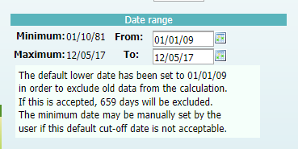
Using older surveys
The default minimum survey date is set to 8 years
However, TRICS contains surveys right back to the 1980’s.
This screen dump of the food superstore land use shows that 659 days of survey information will be excluded from the calculations with the default 8 year cut-off.
The user can change this date if they think it is necessary and justifiable.
There are some Land Uses, say Golf Courses, that might benefit from manually changing the date. It is unlikely that a Golf Course has significantly changed its travel behaviour patterns over the past 15 years or so. So changing this date to include additional sites might be worth considering.
If you change the data – Justify the change within the report and possibly undertake sensitivity testing to show that the additional data did not skew the results

Slide 12
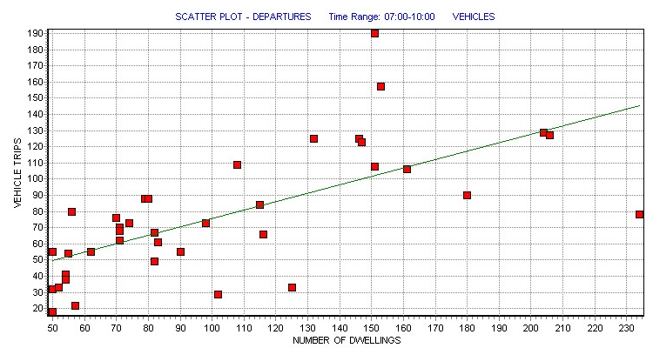
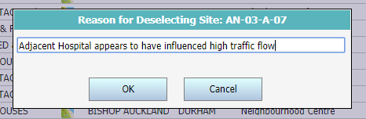
Using scatter plots
Scatter Plots are found by accessing the Rank Order list area of the database
Very powerful tool that enables you to view the actual number of vehicle movements for each selected site.
Do you just remove the outlying sites? – NO
ALL sites within the database are fully validated and are a true representation of actual events on the day of survey, so ALL sites are relevant.
Investigate the sites that raise questions, make a decision upon why their behaviour is different to the other sites. If you then remove these sites make extensive notes in the available comment areas so it is documented within your output.

Slide 13

Paper mountains
Not anymore!
Now everything is sent to the Local Highway Authority in PDF format you can supply ALL the relevant information, all be it within an Appendix.
TRICS easily outputs Trip Rate Reports to PDF and automatically includes every piece of information regarding the filtering process and the sites that have been manually removed.
There is no excuse for not providing a full report, this helps both the Auditor and your own Colleagues dealing with the site in your absence.
If there is a piece of information missing, ask why! It will normally be for a reason, usually because it makes the audit process harder to follow.

Slide 14
Things to include within your report
Do not just state the Trip Rate, even if you do have a full set of TRICS outputs in the Appendices!
Make it clear to the Auditor and any other reader at the beginning of the Trip Rate section which version of the database was used, it also helps to state the release date.
If the stages of the TRICS Analysis have been agreed by other parties, especially the Local Highway Authority, state this early on.
If you have followed the “TRICS Good Practice Guide” as a basis for your Analysis, state this as well.
Summarise you filtering processes and the reasons behind the decisions made. Even if it is obvious, it sometimes helps to write it down.
  “The site consists of a Food Retail development with Petrol Filling Station, therefore, TRICS Land Use ‘01A – Food Superstore’ was used, with the Secondary Filter ‘PFS is present at the site and included in the count’”

Slide 15
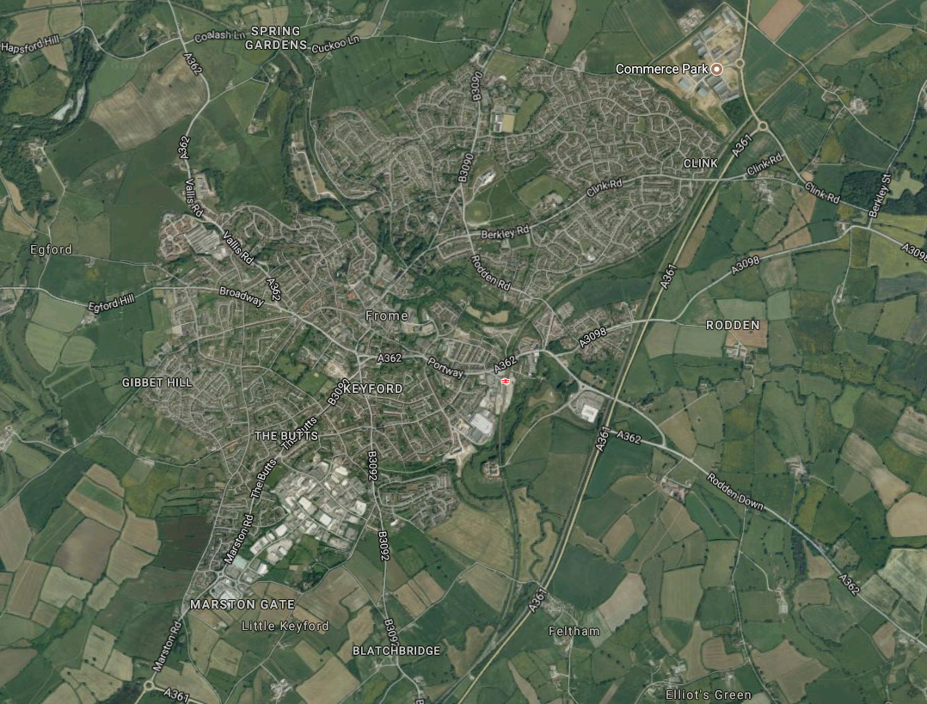
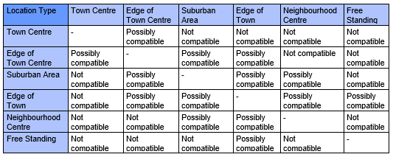
Other Things to include within your report
Using the TRICS Location diagram with an aerial photograph of the site showing its relationship to its surroundings sometimes helps confirm that the location chosen is reasonable.
  “The site location conforms with the TRICS “Edge of Town” location classification. Table 1 of the TRICS Good Practice Guide 2016 shows the compatibility of different Main Location Types. Due to the site being a large distance from the Town Centre, it was decided to only include sites with an Edge of Town, Suburban, Neighbourhood Centre and Free Standing classification.”

Slide 16
At the end of the day
You need to provide every piece of information needed to explain how you got to your trip rate figures.
Do not use over technical terms, these documents also have to be understood by the public. Making it too technical will only make your life more difficult further down the line.
What would you want to see in a report to make you understand how the system was filtered and sites removed from selection.
If there are things missing it could mean they have been left out on purpose.
Do not predetermine trip rates.
Use Sensitivity Tests to see how making different selections actually change the final figures.
Do not accept shoddy work and bad practices. Every site is a potential Appeal, so getting things right at the beginning saves time and money.

