Slide 1

COMMISSIONED TRICS SURVEYS & THE TRICS BUREAU SERVICE – AN UPDATE
IAN COLES, OPERATIONS MANAGER, TRICS CONSORTIUM LIMITED
Notes:
I am going to give a relatively short presentation on two elements of the TRICS project that you should be interested in. These are the commissioned surveys that are processed by TRICS Consortium Limited upon request, and the TRICS Bureau Service, which is a very handy facility for non-TRICS member organisations who are interested in obtaining trip generation information for specific development scenarios.

Slide 2
DIRECTLY COMMISSIONED SURVEYS
Multi-Modal TRICS surveys at sites with or without Travel Plans
Commissioned by developers or their consultant representatives
Frequently a development planning condition requirement
2017 has been another busy year for commissioned surveys
Surveys are already lined up for Spring 2018
Notes:
Firstly we are going to have a quick look at the directly commissioned surveys that are frequently requested by various clients around the UK. These are standard multi-modal TRICS surveys, often at sites with Travel Plans in operation (or at those where Travel Plan implementation may be imminent). They are commissioned by developers, either directly or through their appointed consultants, and they often come about as a result of planning obligations in documents such as Section 106 Agreements. The local planning authority may request that a survey is undertaken to comply with conditions, and so the TRICS team are contacted in the first instance to get things set up. 2017 has been another busy year for the TRICS team in this regard, as many surveys have been requested (especially in the Greater London area), with TRICS now being the only system of trip generation analysis in the capital (as well as across the UK and Ireland). And we have a number of surveys already lined up for the Spring 2018 surveys window, both in Greater London and elsewhere.

Slide 3
COMMISSIONED SURVEY OPTIONS
Organisations can commission TRICS to manage and undertake all stages of the survey process.
Alternatively, organisations can choose to manage the process themselves and then submit data to TRICS for it to be validated and become TRICS Compliant.
A Certificate of TRICS Compliance is issued in either case, once validation is successfully completed.
Notes:
For those that want to undertake surveys to the TRICS standard there are two options. The first is to commission the TRICS to manage and undertake the whole survey process, from the initial site visit, the production of a survey specification, the actual survey itself (working with our TRICS-approved data collection contractors), and the subsequent data input and validation process. TRICS offers years or technical experience in managing surveys, so this is considered the most robust option for delivering the work. Alternatively, organisations can of course decide to manage the process themselves, following the TRICS multi-modal data collection methodology. In such cases, TRICS offers a service of data input and validation, to ensure that the resulting finalised data is TRICS Compliant. A certificate to this effect can be issued following the successful validation of any ad-hoc survey, as long as the data has been fully validated to TRICS standards.

Slide 4
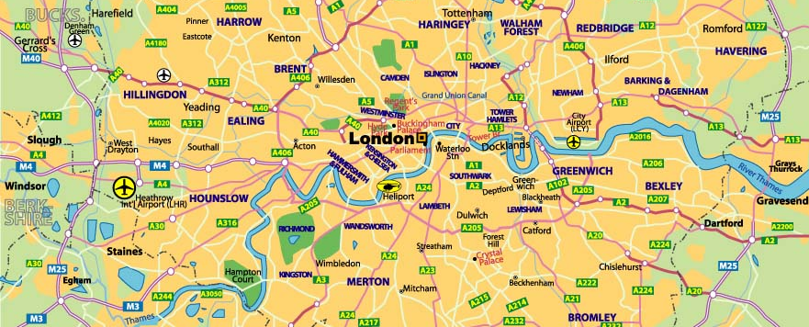
COMMISSIONED SURVEYS IN GREATER LONDON 2017
In 2017 there have been 15 ad-hoc commissioned TRICS surveys in the Greater London area, which are in addition to the standard regional programme of surveys being undertaken in the capital.
Notes:
This year, as mentioned before, has been another busy one in terms of commissioned surveys, and particularly so in the Greater London region. Now that TRICS is the standard system of trip generation analysis in London (as specified in TfL’s own guidance), the TRICS team have been inundated with requests for surveys in the capital. This year we have undertaken 15 such surveys in London, all of which have successfully gone through validation testing. It should be noted that these surveys are in addition to a regional programme of surveys commissioned by TRICS as part of our standard UK and Ireland data collection programme for 2017. So this means that the database is filling up nicely with surveys in the capital.

Slide 5
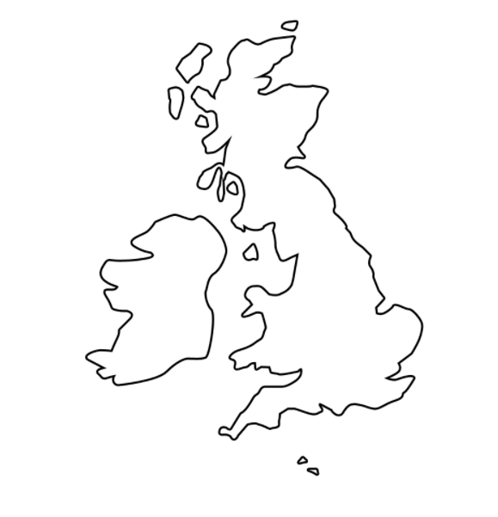
COMMISSIONED SURVEYS (OUTSIDE OF LONDON) 2017
Outside of Greater London there have been 7 surveys commissioned, again in addition to any of the standard regional data collection programmes this year.
Notes:
Outside of London we have also been undertaking commissioned surveys, and in 2017 there have been 7 of these. In any given year there may be between 6 and 20 surveys commissioned in other regions, again in addition to the standard programme of data collection.

Slide 6
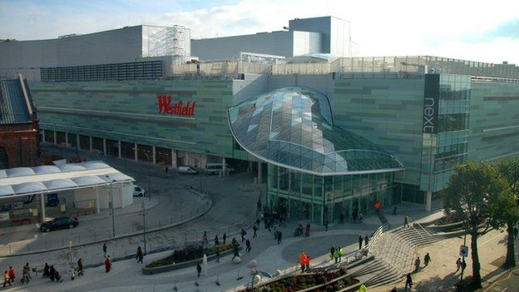
HEADLINE SURVEYS IN 2017
Westfield, Shepherd’s Bush
Olympia, West Kensington
University of Chichester, Bognor Regis
Sky, Isleworth
Notes:
Here are a few examples from the 22 surveys commissioned by clients this year. By far the biggest survey we have ever been commissioned to undertake (in terms of relative sheer volume of movements) was the huge Westfield development in Shepherd’s Bush, London. In fact, 2017 saw a few larger-scale surveys take place, including the Olympia exhibition centre in West Kensington, the University of Chichester in Bognor Regis and Sky’s headquarters in Isleworth. As can be seen here, TRICS can deal with any size of survey, be it a small store or housing development up to the more demanding type of large-scale surveys such as the examples shown. These larger surveys do challenge us, but we are able to adapt our survey methodology on a case by case basis to ensure that multi-modal surveys are fully delivered to client requirements.

Slide 7
THE TRICS BUREAU SERVICE
A facility that allows those without access to the TRICS system the option to purchase trip generation data from TRICS.
Bureau membership available to those who use the service more often, offering a discount on cost.
Often a stepping stone towards full TRICS membership.
Notes:
After that brief recap, I’d like to move on to the use of the TRICS Bureau Service, which you may or may not be aware of. This is a facility that allows those without membership access to the TRICS database to obtain trip generation information through working with the TRICS team. For a set fee, trip generation reports can be provided to those who may not require such information frequently enough to justify a full TRICS membership. For those who might need data through the Bureau Service more often than others, TRICS also offers a Bureau Membership scheme which provides discounted trip generation reports in return for an annual membership payment. The TRICS team has found over the years that many organisations who start off using the Bureau Service go on to become full TRICS members, the facility is often a very handy stepping stone in this respect.

Slide 8
BUREAU SERVICE – THE PROCESS
Client contacts TRICS and explains development scenario.
The TRICS team suggest suitable sites within the TRICS database.
Upon agreement of suitable sites, trip rate calculations are undertaken.
Data is supplied to the client along with an invoice.
Notes:
So how does the Bureau Service process work? Well, in the first instance, a client will contact the TRICS team and will explain the development scenario for which trip generation data is required. The TRICS team will then suggest suitable sites from within the TRICS database that could fit with the requested scenario, and once this the final dataset has been agreed the trip generation calculations can then be undertaken. Sometimes there needs to be a bit of back and forth communication between the client and the TRICS team to make sure that all requirements have been met (and in some cases sites are quite complex and require quite a bit of work and careful database filtering), but eventually The TRICS team will produce a report of the outputs from TRICS, and this is then forwarded to the client along with the invoice for the work.

Slide 9
USE OF THE BUREAU SERVICE 2015-2017
USAGE 2015
USAGE 2016
USAGE 2017 (16 NOV.)
50 reports produced
79 separate trip rate calculations
56 reports produced
74 separate trip rate calculations
47 reports produced
58 separate trip rate calculations
Notes:
We can have a quick look at the usage of the TRICS Bureau Service through 2015, 2016 and 2017 (to mid October). As you can see, the use of the service has remained quite steady. However, it should be noted that in 2017 we saw some of our more regular users of the Bureau Service move on to become full TRICS members, and that explains the slight reduction of use of the Bureau Service this year (to date). The Bureau facility nonetheless remains very popular with non-member organisations.

Slide 10
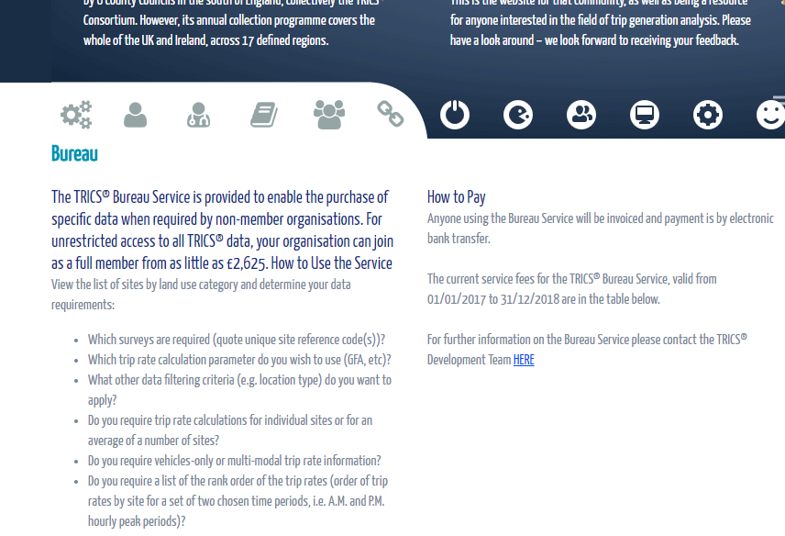
www.trics.org
The TRICS website provides details on costs and how to pay for purchases through the Bureau Service.
Notes:
For more information about the Bureau Service you can visit the TRICS website at www.trics.org. There you will also find more information on the pricing structure.

